Slide 1

Testing BME680 sensor for air quality seminar work Authors: Metodija Bucevski, Jernej Koželj
14.5.2021

Slide 2
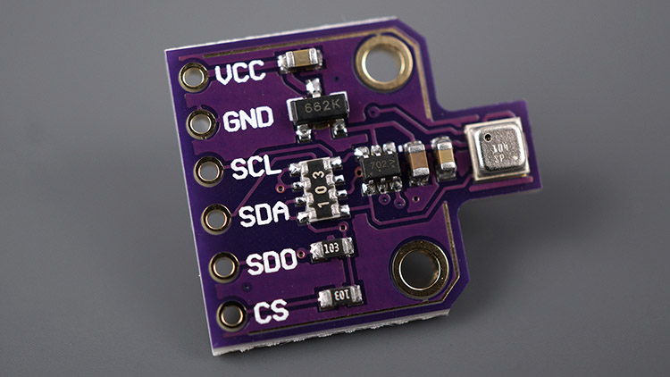
Introduction
BME680 is an environmental digital sensor.
Great for indoor air quality control.
Temperature, humidity, air pressure and gases.

Slide 3
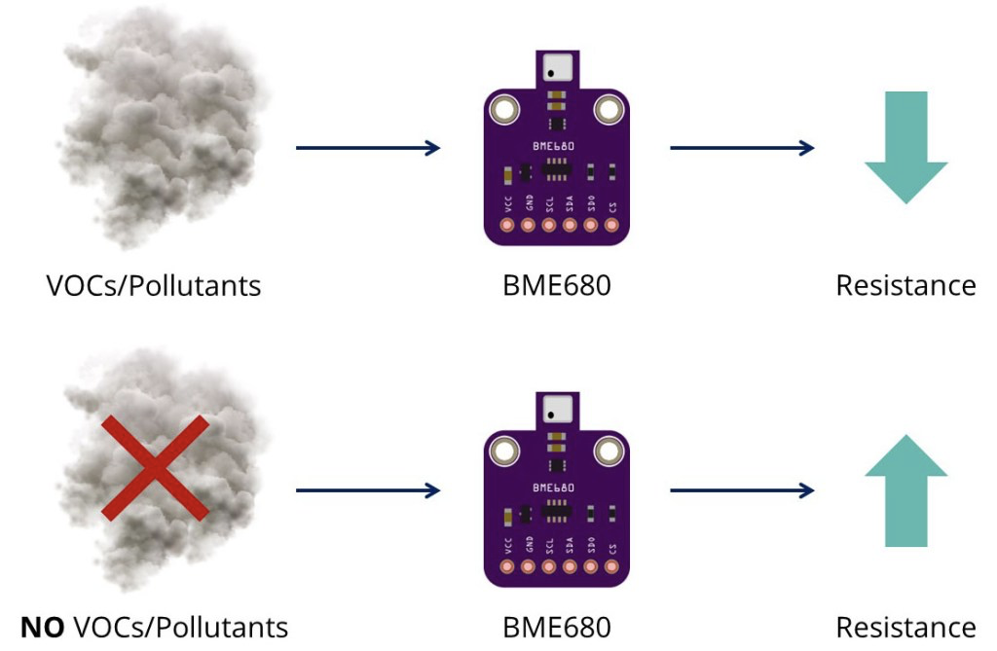
BME680 Gas sensor
Can detect VOCs in the air.
VOC (Volatile organic compounds).
Gives qualitative idea of VOCs in the air.

Slide 4
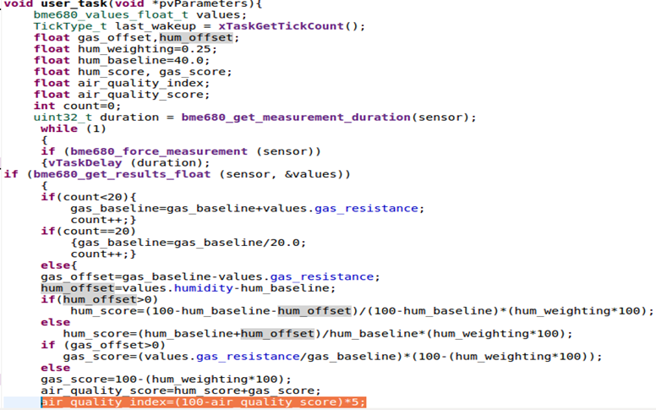
Air Quality Index

Slide 5
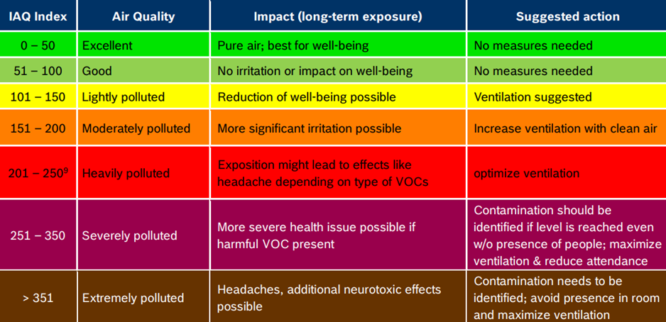
Result interpretation

Slide 6
Possible improvements
•Assume relevant data to be 24h (sufficient 20 min.) after starting the measuring.
•Gas baseline:
–Longer time period
–Specific room conditions
–Shifting baseline to a new level
•Smoothing short spikes in readings.

Slide 7
Experiments
Testing the sensor for air quality.
Using the I2C protocol for communication.
Using Wi-Fi communication for data transfer to MQTT broker.
Lighting the LED if air quality above/below threshold.

Slide 8
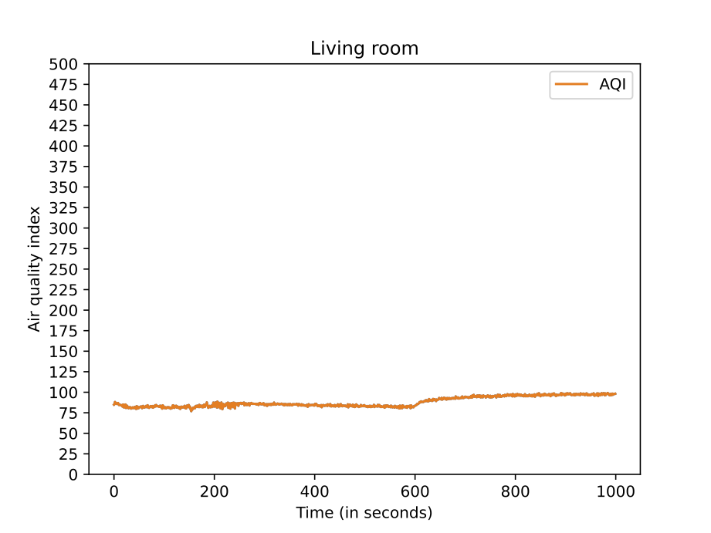
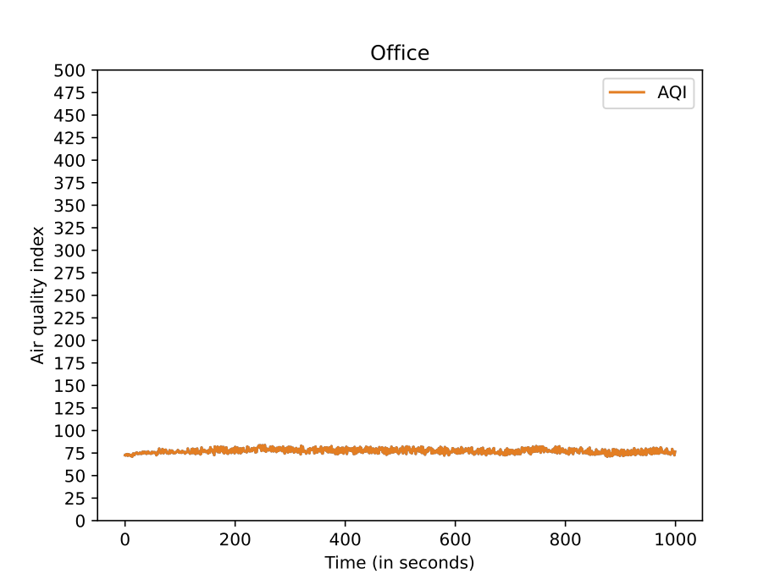
Experiments
Tested the sensor in three different rooms.
Living room had the highest AQI.
Office had pretty good AQI, slightly better than living room and a bit worse than bedroom.

Slide 9
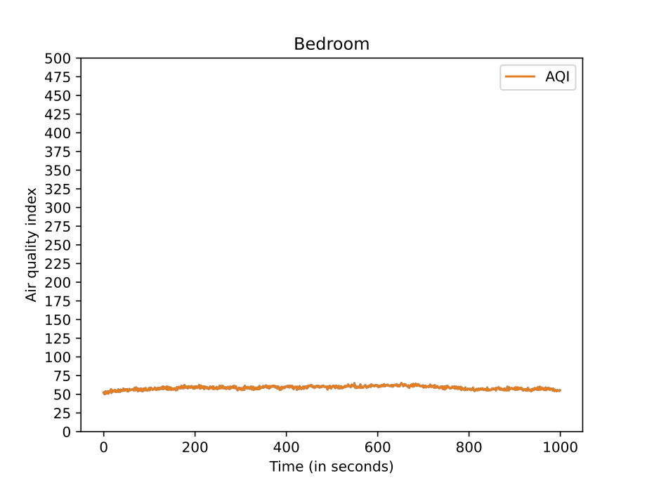
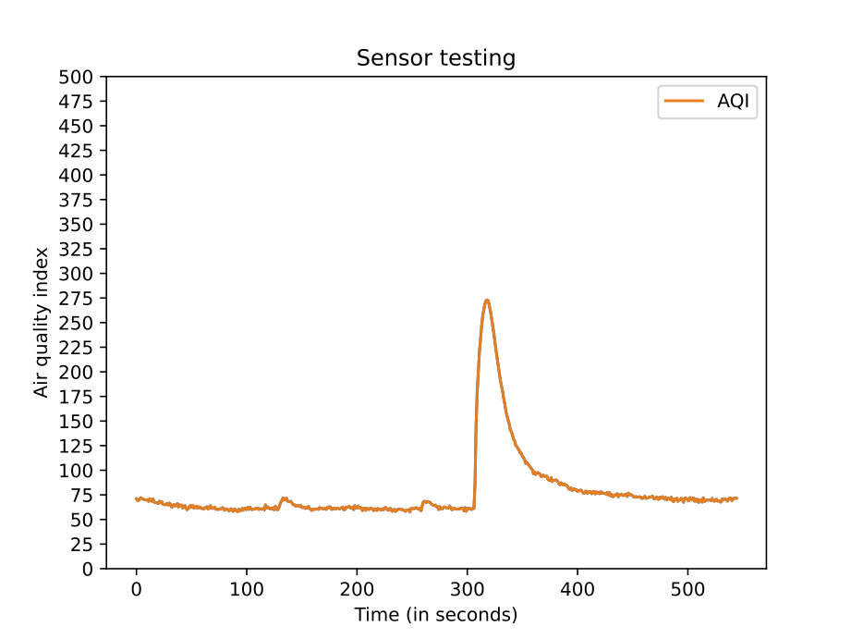
Experiments
Bedroom was the best because of ventilation.
In the last picture we gently blew on the sensor, so that is the spike.

Slide 10
Conclusions
Problems with Eclipse...,
BME680 makes a good air quality indicator for home use,
We should make more effort to regularly check the AQI indoors.

Slide 11
Thank you for your time.

